Slide 1






Presentation to PNGRB
A JOINT UNDERTAKING OF
27.06.2023
LPG EQUIPMENT RESEARCH CENTRE

Slide 2

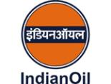


LERC is a unique collaborative venture of the three Oil Majors in India under the aegis of the Ministry of Petroleum and Natural Gas.
LERC is the only entity in India fully dedicated to the Research & Development efforts in the LPG Equipment and Business Stream.
Set up in the year 1990 to carry out R & D in the LPG business segment, LERC has now completed more than 30 years of dedicated service to this Industry

Slide 3





A
LERC has been recognized as a Scientific and Industrial Research Organization (SIRO) by Dept. of Scientific and Industrial Research (DSIR), Government of India.
LERC is accredited for technical competence by National Board of Accreditation Laboratories (NABL) for testing services as per ISO 17025:2017 standard thus providing customers a ready means of competent and reliable services.
LERC is also recognized by Bureau of Indian Standards for testing of LPG Equipments as per the relevant Indian Standards.
LERC is also recognized by SASO for testing of LPG Equipments as per the relevant Indian Standards.

Slide 4
Brief about LERC
LERC is a well-known R & D and Testing entity for Oil Marketing Companies.
LERC is recognized by various reputed organisations viz.
  PESO
  Dept of Scientific and Industrial Research
  NABL
  SASO
LERC is one of the members of various Technical Committees of BIS:
  MED 16 (Gas Cylinder committee), PGD 26 : Metrology
  MED 23 (Burning Gas Appliances committee), PCD 29 : Rubber related
  MED 26 (Ethanol Stoves) PCD 3 : LPG
  PCD 13 (Rubber and Coal related Products)

Slide 5
Brief about LERC
LERC is closely working with BIS for development of New Standards and modification of existing standards. Some of them are
  New IS 17613 for Welded Aluminium Alloy cylinders
  New IS 16280 for Variable High Pressure Regulators.
  New IS 18380-2023 for Ethanol Stoves
  New IS 17153 for PNG stoves.
  New IS 15020 for Methanol Stoves
  New IS 16646 : 2017 for Transportable Refillable Fully Wrapped Composite Cylinders for Liquefied Petroleum Gas (LPG)
  Amendment of IS 9798 incorporates DPR inlet sealing Test procedure, making it mandatory for all DPR manufacturers.
  Amendment of IS 4246:2002 with regards to Cook-Top
Collaborating with MoPNG on investigation of LPG related accidents as well as development of new requirements

Slide 6
PNG Stove
LERC has extensive experience in designing, developing and testing LPG Stoves
LERC has licensed technology to more than 35 manufacturers across India and assisted in marketing LPG Stoves
LERC has developed the high thermal efficiency stove which has helped in saving LPG and reducing carbon footprint as below
LERC has the most modern Combustion Lab in India which engages in various testing research and development activities
We now propose to extend this expertise to the field of PNG

Slide 7
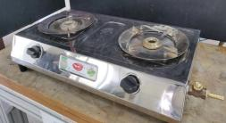
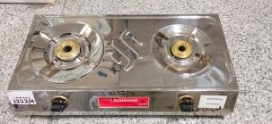
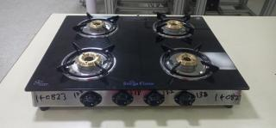
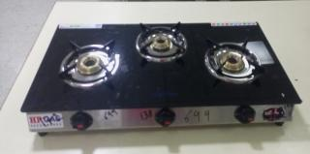
HIGH EFFICIENCY LPG STOVES DEVELOPED BY LERC
Thermal Efficiency 74%!
New target 75%+ !!!!
Initial prototype achieving 75% thermal efficiency
Commercial model with BIS approval manufactured by one Vendor
High Thermal Efficiency (more than 74%)achieved on repeatable basis.
Approval for Implementation through Technical Specifications with nominal Charges has been obtained.
Thirty Four number of Vendors have taken Technical Specifications from LERC.
Currently offering the technology to high end manufacturers

Slide 8
HIGH EFFICIENCY LPG STOVE
Thermal Efficiency 74%!
New target 75%+ !!!!
Considering average conversion of 10% INDANE LPG customers annually, the savings of LPG will be huge.
Considering average monthly consumption per customer as 10 kg, the annual consumption of LPG towards domestic cooking is = (10% of 30 Crore customers) * 10Kg * 12 months = 360X 10⁷ Kg.
Considering a LPG Stove having an Efficiency of 69% which is enhanced to 75% by the above mentioned modifications, the savings is (1-0.69/0.75) *100%=8% approx.
Savings of LPG per annum is = 360 x10⁷ x 8% kg = 28.8 x10⁷ kg approx.
Considering the LPG product cost as Rs. 50/- per KG (assumed).
The LPG saving is = 28.8 x 10⁷ x 50/- Rupees 1440 Crore per Annum approx. (with conversion of only 10% of customers to High Efficiency Burner)
LPG has a lower carbon footprint than MS and HSD. One gallon (2.21 Kg) of LPG emits 12.52 pounds (5,680 grams) of CO2 when combusted. That is 1 Kg of LPG has a carbon footprint of 2.57 Kg. (HSD 3.16 Petrol 3.088)
Savings of LPG Per Annum is 28,80,00,000 kg (288 TMT) approx. Which means there is a reduction in Carbon footprint of 740.16 TMT.

Slide 9
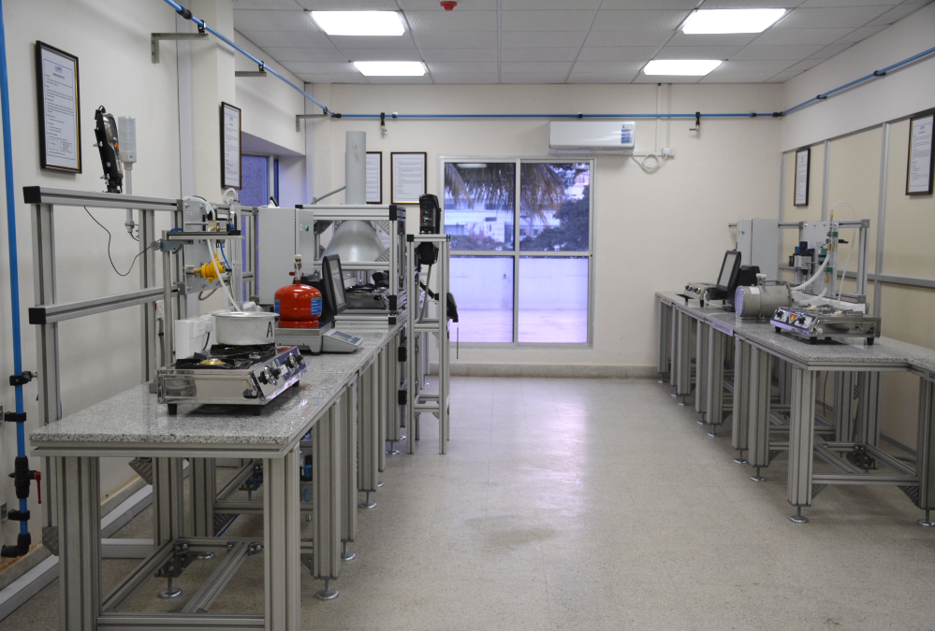
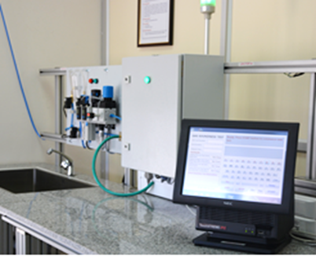
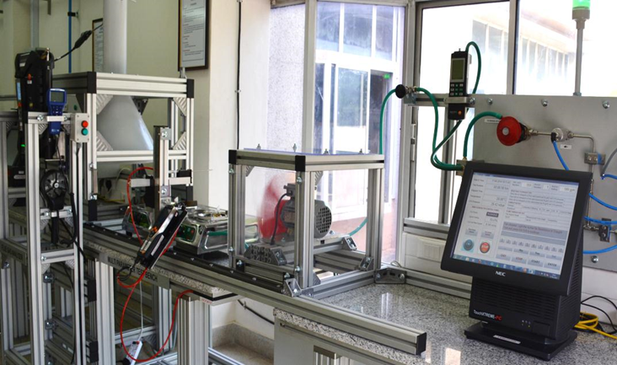
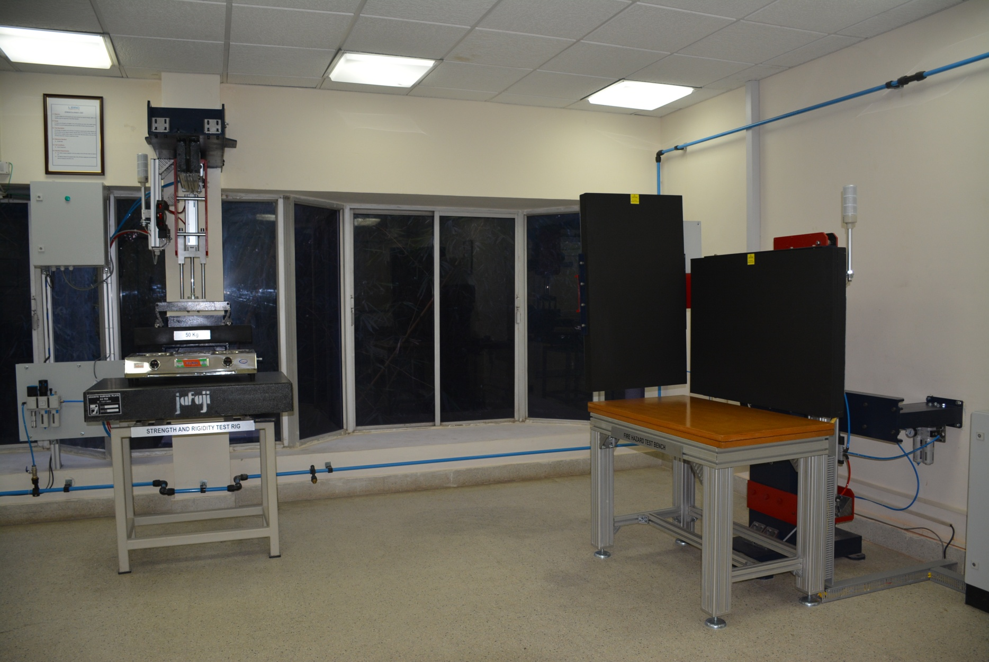
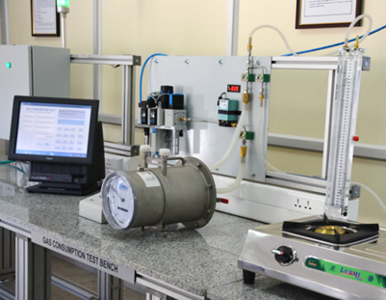
STATE OF THE ART COMBUSTION LAB AT LERC
Testing of LPG Stoves as per IS 4246:2002 and IS 5116:1996
NABL accredited as per ISO 17025:2017

Slide 10
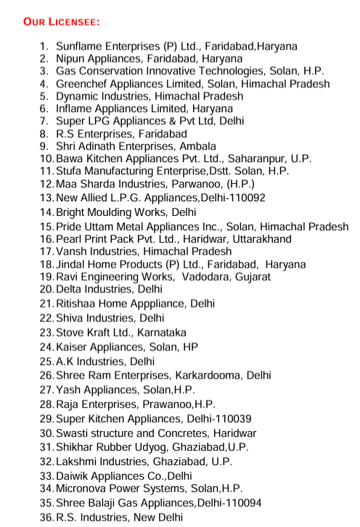
STATUS OF PNG STOVES IN MARKET TODAY
Licensed from IIP Dehradun
Status
Out of these manufacturers 29 have obtained BIS approval
However hardly 3-4 are manufacturing PNG stoves currently due to the abysmally low demand.
Many of the manufacturers have cancelled their licenses

Slide 11
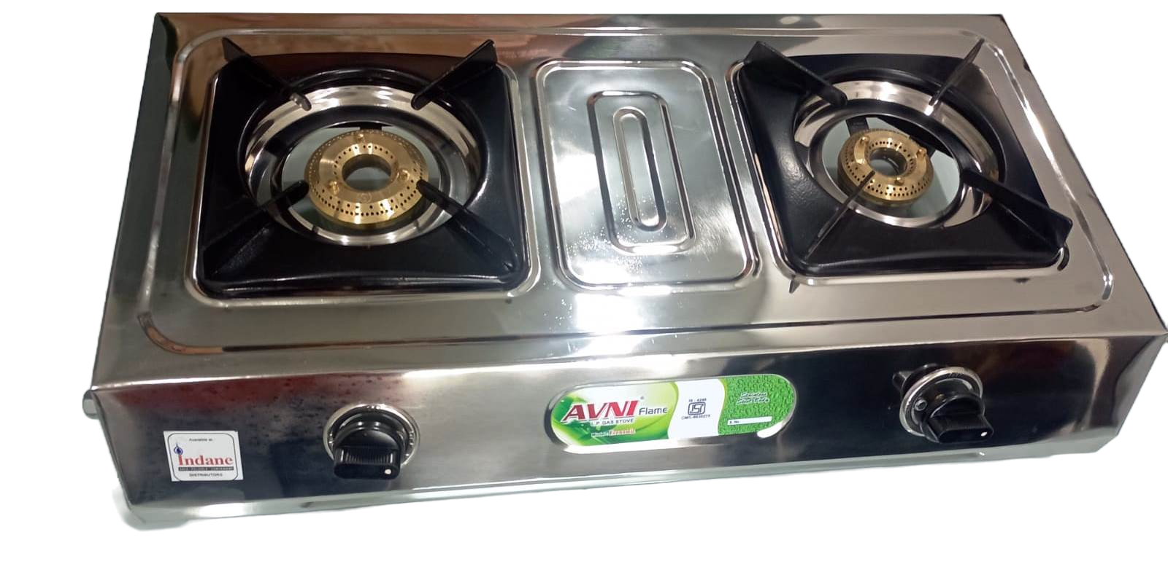
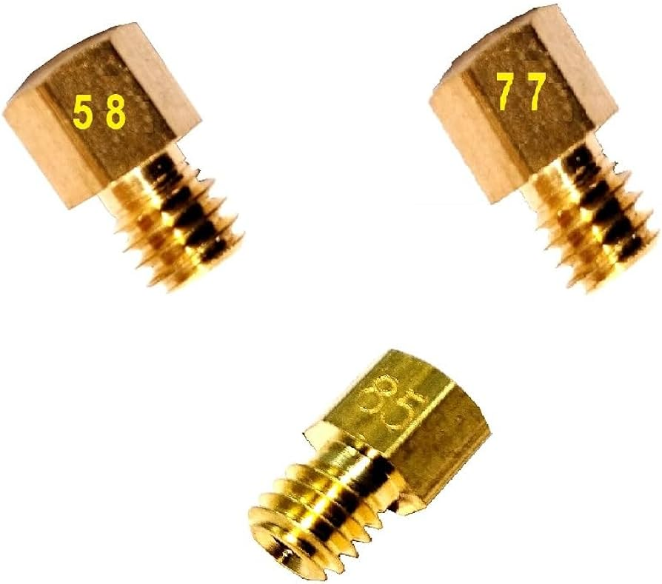
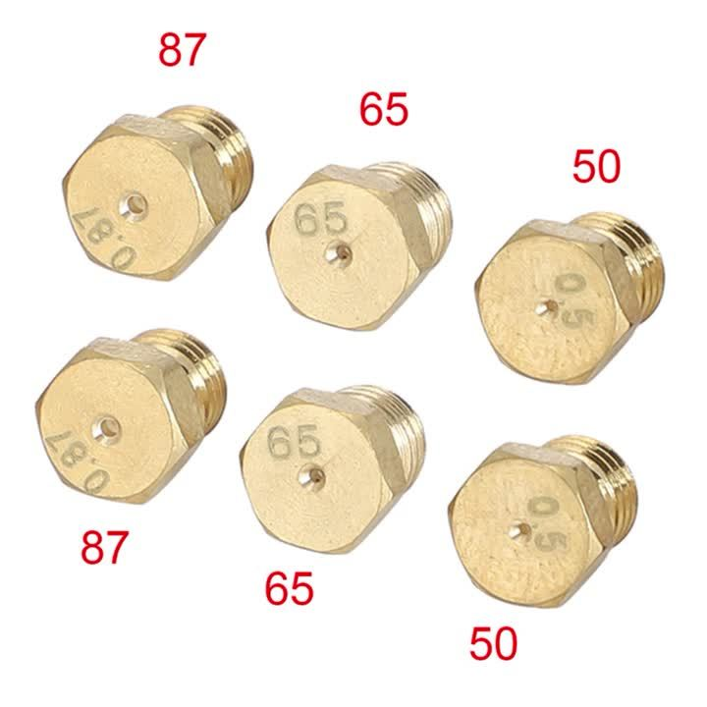
LPG STOVE
STATUS OF PNG STOVES IN MARKET TODAY
LPG Pressure 30 M-bar
Jet size Small burner 50 L/h to 65 L/h
Drill size small 0.68mm,0.70mm,0.72,mm0.74
Jet size big burner 70 L/h to 80 l/h
Gas consumption (- +8)
Drill size Big 0.78mm,0.8mm,0.82mm
Burner hole 1.8mm
Injector Jet in various sizes

Slide 12
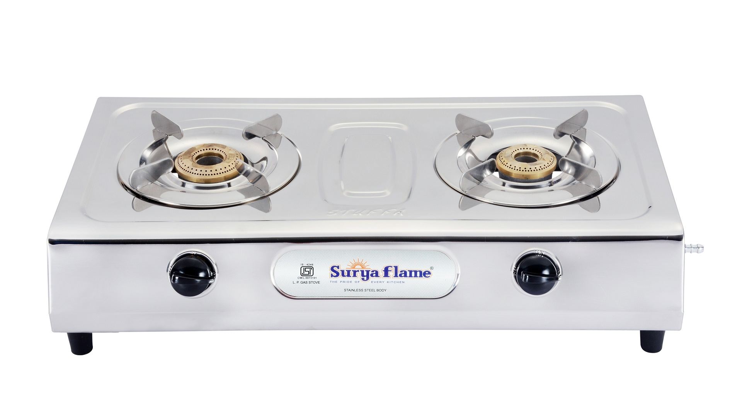
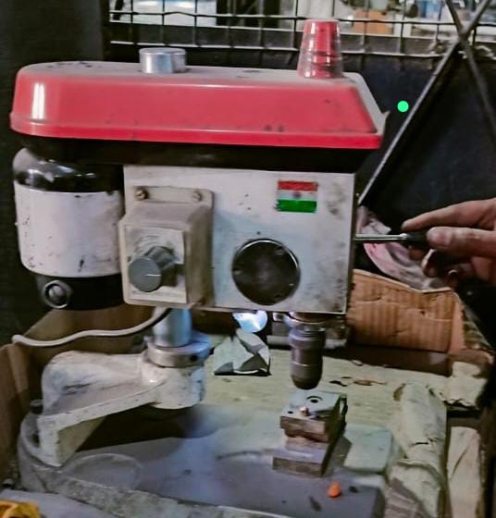
1.PNG Pressure 21 M-bar
2. Jet size Small burner 171L/h to 185 L/h
3. Drill size small 1mm
4. Jet size big burner 191 L/h to 200 l/h
5. Drill size Big 1.5mm
6. Burner hole 2.2mm
STATUS OF PNG STOVES IN MARKET TODAY
PNG STOVE
What are the PNG Customers doing ??
Changing the injector Jet of LPG Stove
Normally LPG Stoves have jet sizes of 70-80 & 50-61. This is changed to 210 & 185 ltrs by using a thick needle / drill.
For Sim condition Gas cock size has to be drilled to 0.6 mm
Increasing the burner hole from 1.8 mm to 2.2 mm by drilling

Slide 13

STATUS OF PNG STOVES IN MARKET TODAY
Implications
Drilling of Components jeopardize the structural integrity.
May result in serious safety hazards due to immediate leakage or delayed effects.
Thermal efficiency of the stove decreases due to imbalance of the design
Gas Consumption is not uniform and becomes haphazard
BIS approval becomes invalid and the customer is under the wrong impression that this is a Govt approved procedure

Slide 14
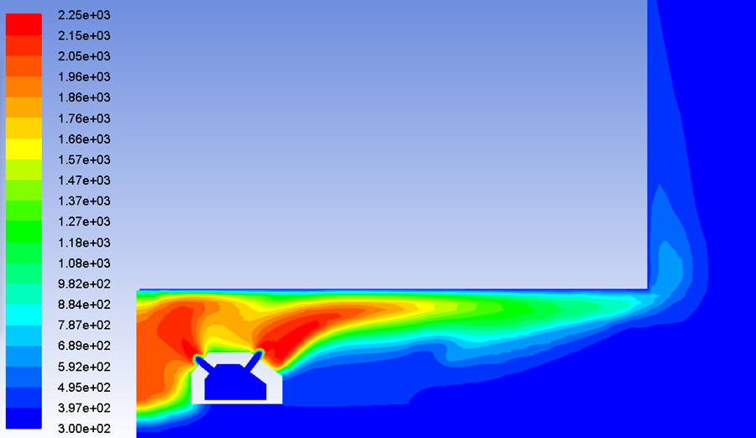
PNG STOVES – LERC INITIATIVES
CURRENTLY BIS STANDARD HAS A TARGET OF 55% EFFICENCY. TO INCREASE THERMAL EFFICIENCY OF PNG STOVE LERC PROPOSES TO
Burner Diameter and Port Arrangement – Design burners to maximise heat transfer efficiency and minimise heat loss.
Burner Material – use material with high thermal conductivity and durability like brass or ss.
Gas Flow Control – Precise control valves that allows adjustment of gas flow rates for getting required flame size and heat output.
Air Fuel Ratio – To ensure correct air fuel ratio for combustion. Proper mixing of air and gas prevents incomplete combustion and reduce emissions.
Temperature (K) distribution at mid-plane of the computational domain
Velocity (m/s) distribution at mid-plane of the computational domain

Slide 15
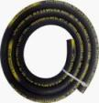


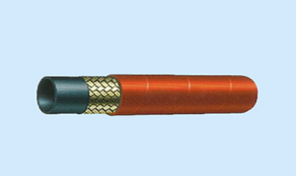
SURAKSHA HOSE AND LERC
LERC has many patents in its kitty including Suraksha LPG Hose and Design of High Thermal Efficiency LPG Stove.
LERC has done many innovations including Suraksha LPG Hose for Domestic as well as for Industrial applications.
Supersuraksha Industrial Hose
INNER LAYER-LINING
(NITRILE BUTADIENE RUBBER)
THREE WIRE BRAIDED REINFORCEMENT
(0.3MM Brass Coated Steel wire)
OUTER LAYER- COVER
(NBR and POLYVINYL CHLORIDE )

Slide 16
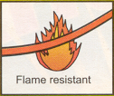
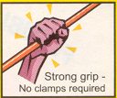
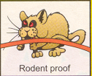
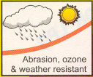
SURAKSHA HOSE AND LERC
Till LERC came up with the design and manufacture of the SURAKSHA Hose, domestic accidents due to Hose rupture, Pin Holes, rat bites, Chemical failure, Mechanical damage etc was rampant.
Because of its inherent strength due to reinforcement, remains firm at the stove and regulator ends.
Excellent grip strength
Difficult to remove and can withstand heavy pulls and weights while handling.
Wire reinforcement makes it strong and prevents any attack by rodents without damage to hose.
Connection will be safe even if rodent menace at home
The outer layer of hose is self-extinguishing and has improved resistance to flame propagation.
Incase of accidental situations due to keeping of burning objects like candles near the hose, it does not catch fire easily.
The outer layer of hose is so designed that it has a longer life against Ozone, weather degradations.
Hence resistance to development of cuts and cracks, which are the most common sources of leakage

Slide 17
SURAKSHA HOSE AND LERC – cycle of quality
LERC has been a licensing authority for manufacturing of Suraksha LPG Hose as per the IS 9573 and has complete control over the production of Suraksha LPG Hose including testing and assuring the quality. The BIS standard has also been formulated as per the original Suraksha hose developed by LERC.
Manufacturers are inspected by LERC and license granted for manufacture. The technical documemnts is to be strictly adhered to
LERC is administering the Quality Disciplinary Guidelines also to take action against the erring manufacturers.
While the hoses are procured by OMCs from these manufacturers and distributed to LPG Distributors and end consumers through stockists, Samples are picked up from the LPG Distributors by Officers of OMCs and sent to LERC for testing .
The failure analysis indicates that despite well devised systems of controls, samples are failing in various parameters.
Immediate Penal action including suspension / terminal as per QDG is intitiated. Hence the control over the full cycle is maintained.

Slide 18
Focus is now on PNG - Proposal
LERC is now focusing on PNG also.
Presently, hoses as per 9573 are being directly procured by CGD companies and given to PNG customers.
However, since no testing is being done on the hoses supplied to PNG customers, the quality of hoses and the safety of PNG customers are at stake.
LERC is proposing to ensure the quality of hoses supplied to CGDs by implementing the same set of controls.
LERC will license the technology of Suraksha hose to all interested manufacturers under the same guidelines as being followed for OMCS.
QDG will be administered by LERC to ensure control at manufacturer premises.
Regular testing of samples collected from end consumers shall be conducted and results shared with CGDs .
Regular MIS and quality improvement co-ordination with CGDs.
The maintenance of quality cycle and domestic consumer safety.

Slide 19
Focus is now on PNG – A specific hose
IS 9573 Part 1 and Part 2 deals with Hoses for LPG. While there are no Indian standards for PNG Hoses international standards are available.
Since the properties of PNG and LPG are different, LERC is developing a new hose exclusively for PNG.
ISO 2928 and EN 1762 details the requirement for PNG ( and LPG) hoses.
LERC has developed a draft BIS standard which will be put up for discussion and further adoption at the next PCD-13 meeting.

Slide 20
LERC proposals
Solutions are now available for PNG Stoves and PNG Hoses
Empaneling LERC for testing of PNG Stoves and Hoses being used in PNG Network, supplied through CGDs and ensuring quality.
Development of new IS Standard for PNG Stoves and hoses as per the requirement.
Development (jointly with PNGRB, IIIP and other reputed institutions) of new PNG Stoves and hose exclusively for PNG usage.

Slide 21



