Slide 1
GUJARAT GAS LTD
Adoption of High Efficiency Domestic PNG stoves
27-06-2024

Slide 2
About Gujarat gas ltd.
India's largest City Gas Distribution Company
Gujarat Gas Limited (GGL) is India's largest City Gas Distribution (CGD) Company in terms of sales volume operating in 44 districts in 6 states of Gujarat, Maharashtra, Rajasthan, Haryana, Punjab & Madhya Pradesh and 1 Union territory of Dadra & Nagar Haveli.
GGL has a successful track record of providing uninterrupted services for over 3 decades through a network of more than 39,300 kms. of Natural Gas pipeline, distributing approx. 9.35 mmscmd of Natural Gas. The Company operates 808 CNG stations and has connected more than 21.15 lakh households, over 15,200 commercial customers and more than 4,390 industrial customers.
Domestic connections have risen from 13.5 lakh in 2018-19 to 21.15 lakh in 2023-24, at a CAGR 9.3 %
We make natural gas the safe and preferred energy solution

Slide 3
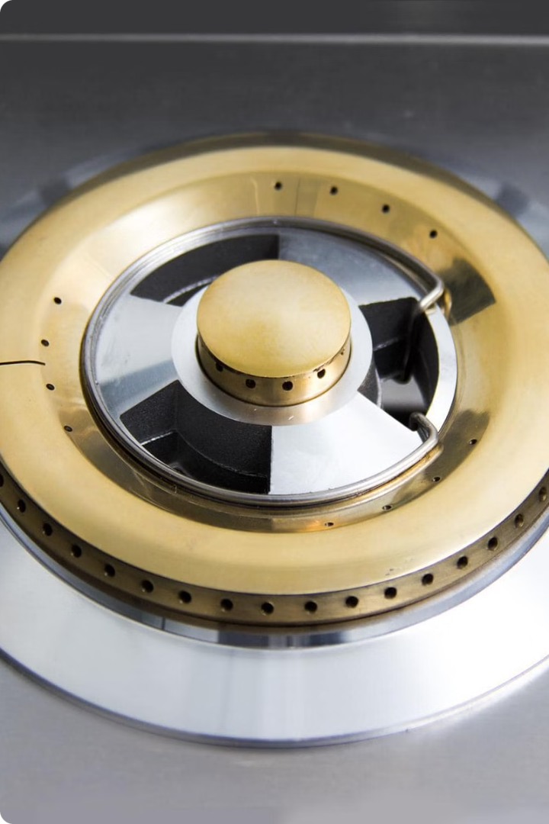
Conversion of LPG Stove
Why to convert LPG Stove to PNG Stove?
  Unavailability of dedicated PNG burner/stove
  Difference in density ( LPG ~ 1.8 kg/m3 and NG ~ 0.58 kg/m3 to ~0.6 kg/m3
Design consideration for conversion of stove
  125 no. jet (orifice) used for burner having capacity 2000 kcal /hr.
  110 no. jet (orifice) used for burner having capacity 1500 kcal /hr.
We make natural gas the safe and preferred energy solution

Slide 4

Advantages of NG Burner over Converted LPG Burner
Increased Efficiency
  Natural gas burners are engineered to burn natural gas more efficiently, reducing energy costs and carbon emissions.
Cleaner Combustion
  Burning natural gas produces fewer particulates and pollutants compared to converted LPG burners.
Safety of Operation
  Eliminations of the changes of “Flame lift” and flame extinguishment
Compatibility
  Natural gas burners seamlessly integrate with existing gas infrastructure.
  Environmental Impact
  Switching to natural gas burners can significantly reduce a household's carbon footprint and environmental impact.
We make natural gas the safe and preferred energy solution

Slide 5
Challenges for adopting PNG Stove
Multiple choice available with customers for LPG Stove
  There are multiple type of LPG Stove available in market like 2 burner stove, 3 burner stove, Glass Top Burners, Hob Burners with Autoignition etc.
Additional cost to the customer to buy dedicated PNG stove
Non awareness to customers about PNG stove
We make natural gas the safe and preferred energy solution

Slide 6
Strategies to Promote PNG Stove Usage
Public Awareness Campaigns
  Educating the existing domestic customers and potential domestic customer about the advantages of PNG stove through local media, meeting at customer premises, distribution of pamphlets etc.
  Ensure availability of PNG appliance in major shopping plaza etc.
  . Regulatory Framework
  Develop a robust regulatory framework that mandates the use of high-efficiency natural gas burners, ensuring a level playing field and driving widespread adoption.
Incentive Programs
  Provision of supply PNG Stove to new customers by CGD entities on subsidize rate.
Accessibility to installation and maintenance services
  Ensuring accessibility to installation and maintenance services is crucial for making the transition seamless for end-users
Work closely by PNG Stove dealer with CGD entities.
Government initiative to stop LPG connections where PNG supply has been secured.
We make natural gas the safe and preferred energy solution

Slide 7
Thank You
We make natural gas the safe and preferred energy solution

