Slide 1

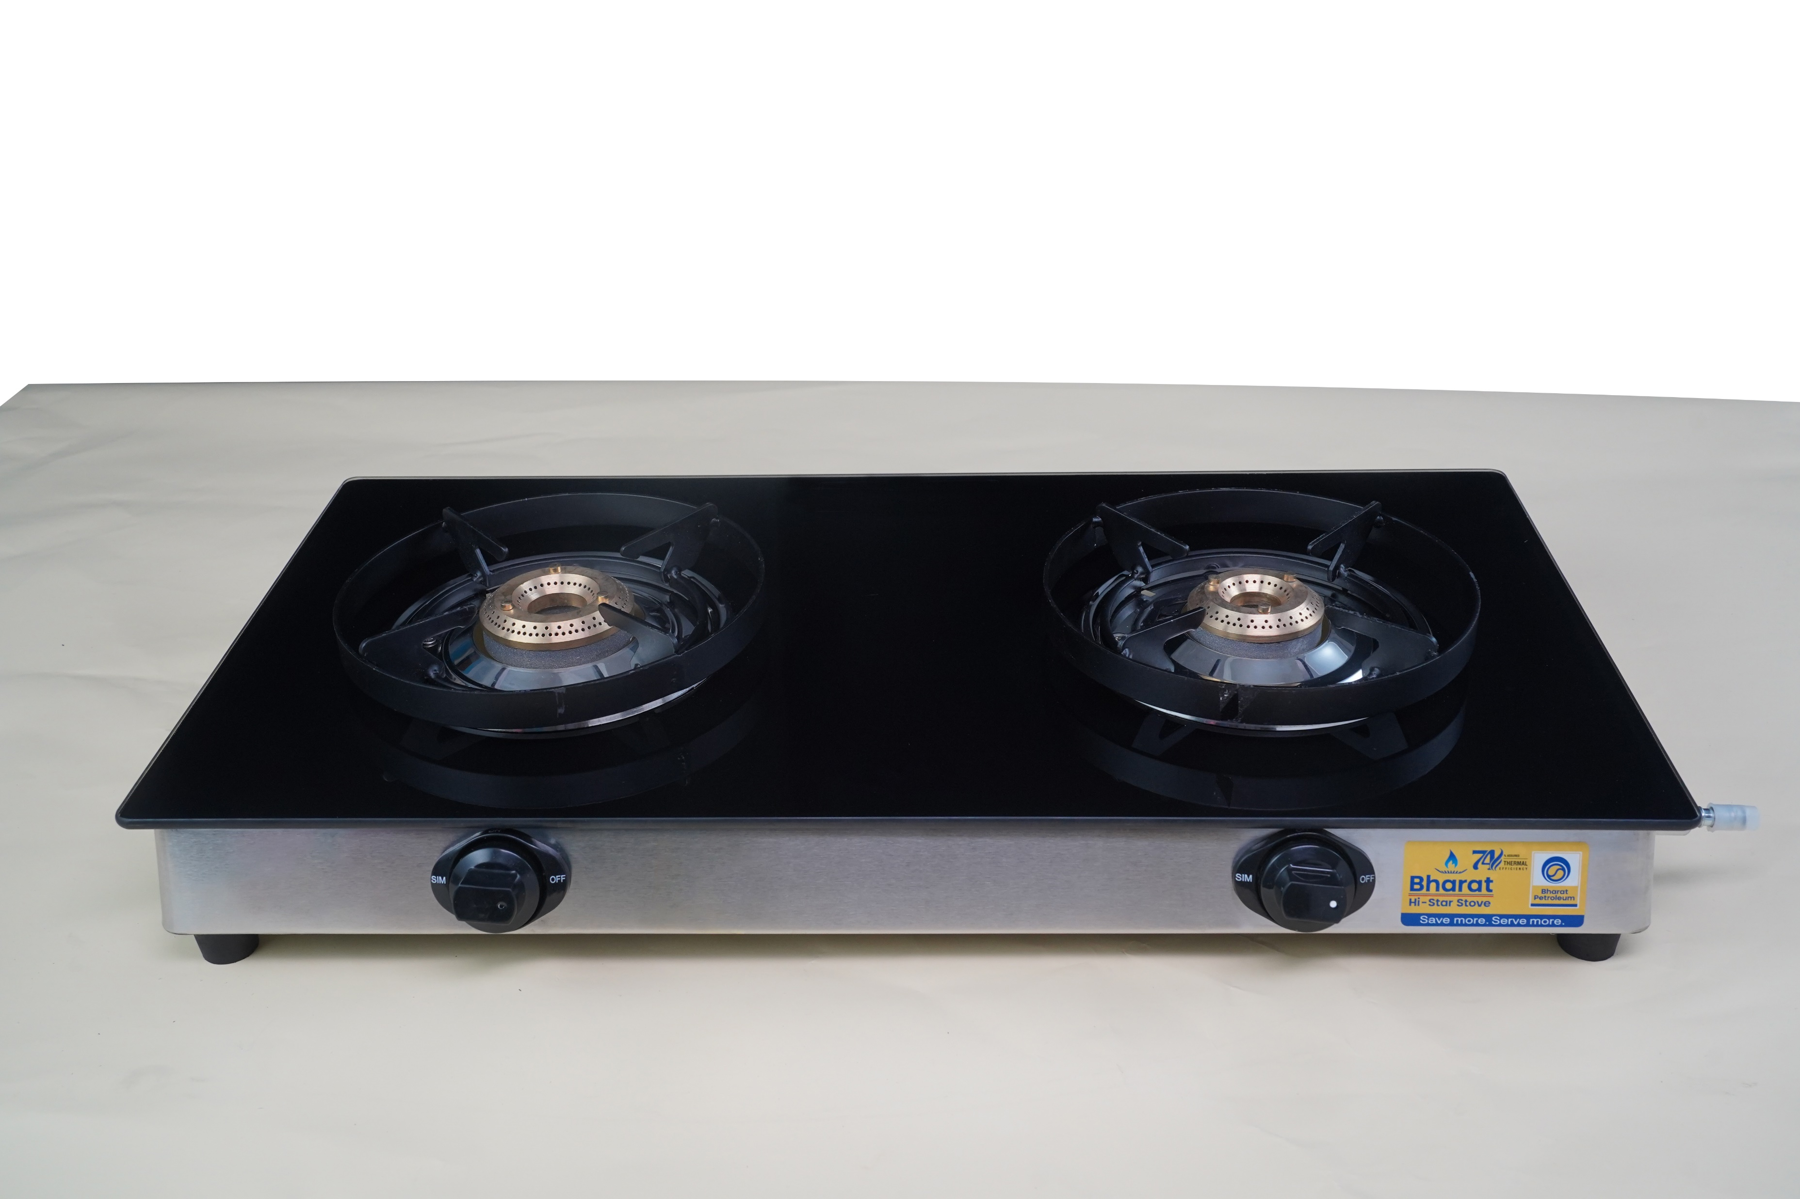
Bharat Hi-Star-PNG-Stove
World's Most Energy Efficient Natural Gas Domestic Cooking Stove
Aniruddha Kulkarni, Manager (R&D)
Bharat Petroleum Corporation Limited

Slide 2

Outline
Present Status of Natural Gas
Bharat Hi-Star Stove – LPG
Need of dedicated PNG stove
Development process
Testing as per BIS
Prototype Preparation
Testing in BIS approved laboratory
Benefits

Slide 3
Present Status
India is predicted to become a Gas-based economy.
The natural gas contribution in India’s energy basket will be increased from 6% at present to 15 % by 2030.
Number of PNG connections at present in the country is 1.2 Cr.
Expected PNG connections by 2030 : 12 Crore
Dedicated PNG stove – Not available in the market
For better tomorrow we are transitioning towards Natural Gas, but are we utilizing the energy effectively?

Slide 4
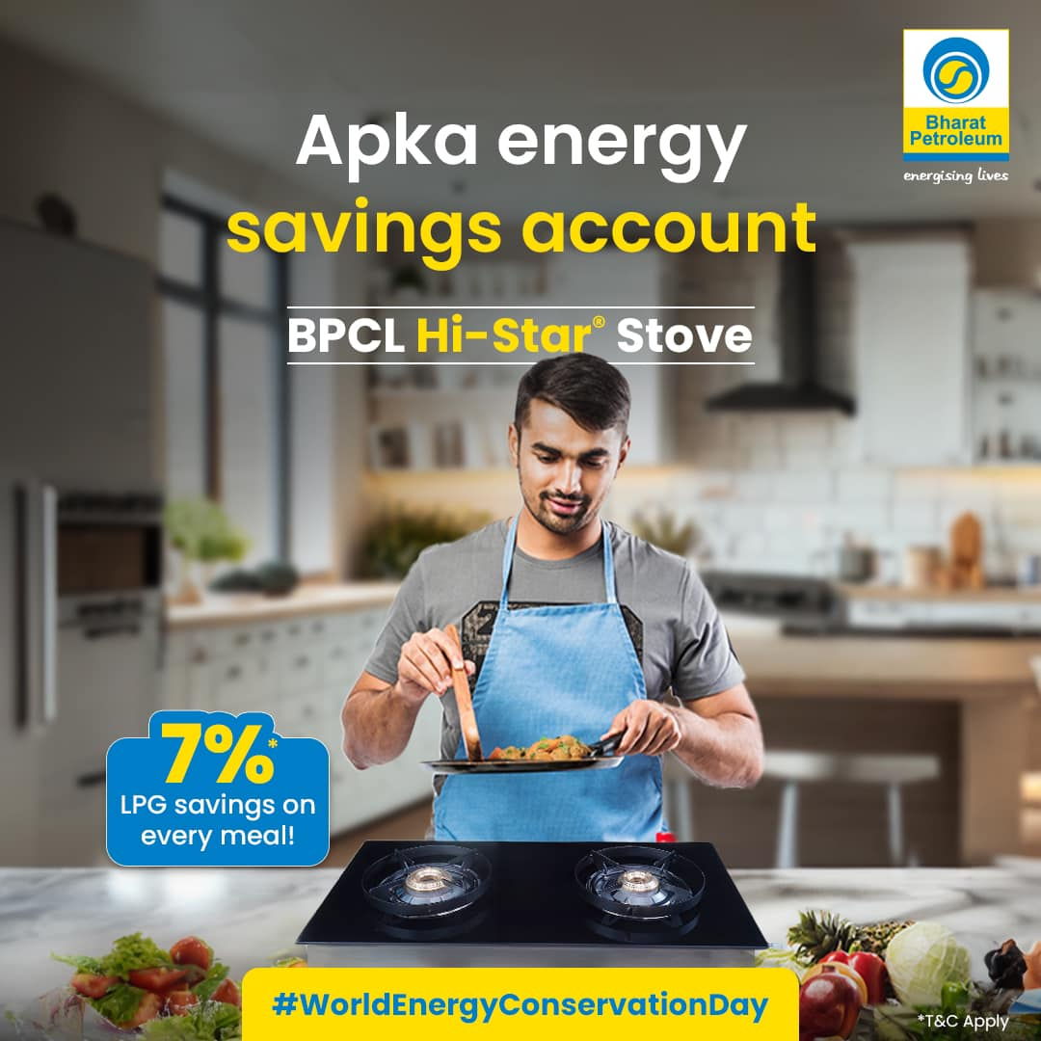
Bharat Hi-Star Stove
World’s Most Energy Efficient Domestic LPG Cooking Stove
Thermal Efficiency 74% plus
BIS Approved
Technology licensing agreement signed with 15+ LPG stove manufacturers
1.5 Lacs units sold
Customer Benefit – Saving of 1 LPG Cylinder per year*
Savings on LPG import
Environmental benefits
Patent filed
Export opportunity

Slide 5
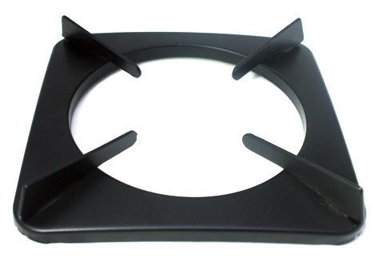

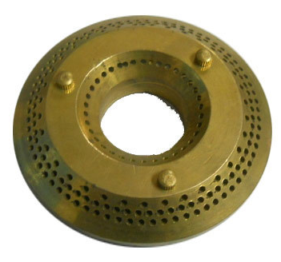
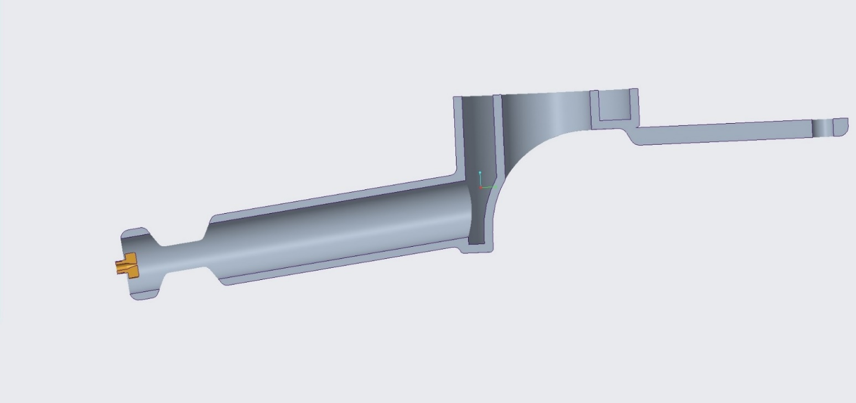
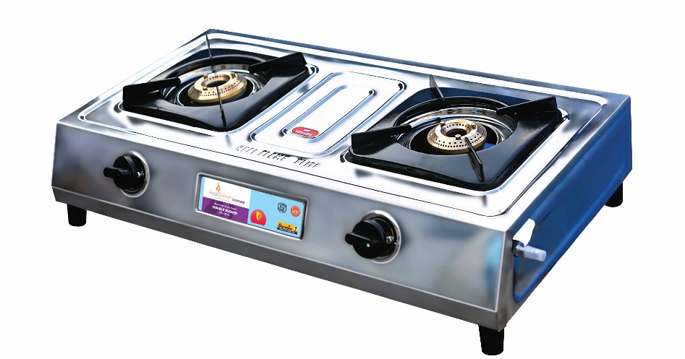
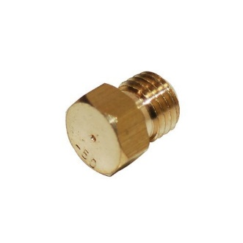
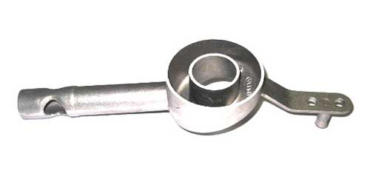
Stove – Working Principle
Bunsen burner working principle
LPG stoves are modified for PNG usage
Efficiency reduction 15-20%
Thermal efficiency observed 50-55%
Need for dedicated PNG stove
Cover Plate
Mixture Outlet
Diffused Air
Diffused Air
Pan Support
Burner Top
Primary Air
Secondary Air
air-fuel mixture
LPG Inlet
Mixing Tube
Cooking Stove
Primary Air
Nozzle

Slide 6
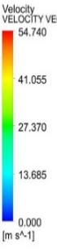

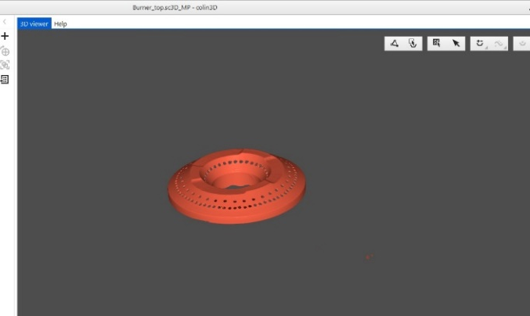
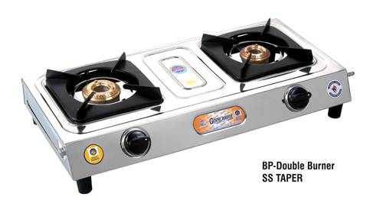
PRODUCT DEVELOPEMT PROCESS
MODELING
3D Scanning
CAD Model Preparation
SIMULATION
Domain Definition
CFD Studies – Cold flow and Combustion analysis
VALIDATION
Prototype fabrication
Experimental testing
Post processing
Parameter identification
Final product preparation

Slide 7
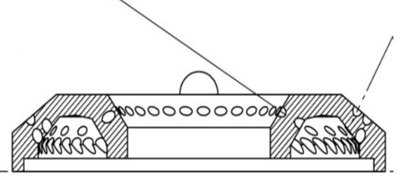
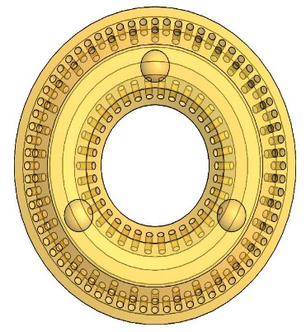
Stove parts design basis:
BURNER TOP
MIXING TUBE
PAN SUPPORT
ø78.2
ø30
Focus Areas:
Inner port inclination angle
Outer port inclination angle
Diameter of port
Orientation of ports
Number of ports on inner side and outer side – upper row and lower row.
Focus Areas:
Primary Air Entrainment Area
Secondary Air Entrainment Area
Mixing tube flow passage – Straight, convergent divergent etc.
Cup Section – Radial profile etc.
Focus Areas:
Pan support design – Rectangular, Circular, Triangular etc.
Loading height
No. of legs

Slide 8
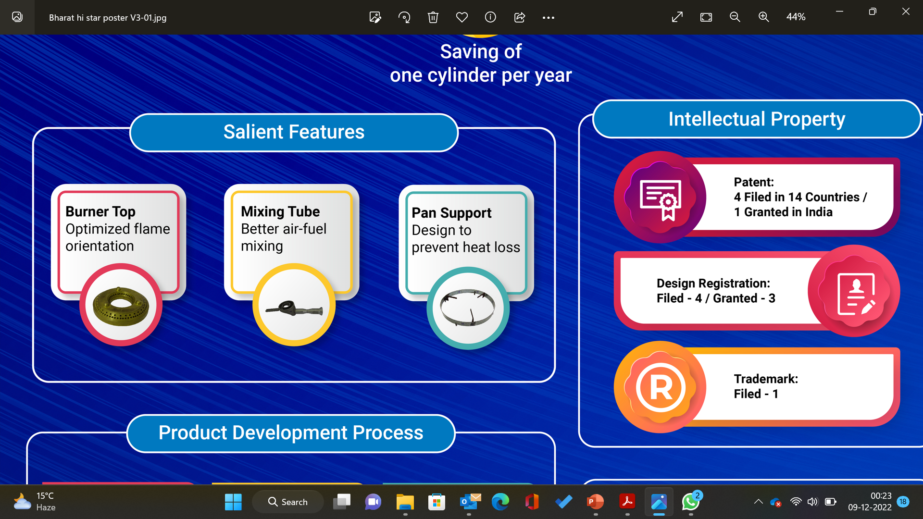
Bharat Hi-Star – NG : World’s Most Energy Efficient Natural Gas Stove
72%plus
Thermal Efficiency
Designed by BPCL Corporate R&D Centre
10 to 15% more efficient than burners available in the market
Patent applied at Indian patent office
25 - 30% savings in PNG consumption

Slide 9
Customer Benefits
Case 1 – New LPG Stove
Thermal efficiency – 68%
After modification for PNG
Thermal efficiency – 50%
Savings with Bharat Hi-Star-NG: 25 – 30% in PNG consumption
Case 2 – Old LPG Stove
Thermal efficiency – 55%
After modification for PNG
Thermal efficiency – 35%
Savings with Bharat Hi-Star-NG: 45 – 50% in PNG consumption

Slide 10
Benefits
Benefit to customer: 25 – 30% savings in gas bills
Benefit to Nation: Savings in Natural Gas Import and savings on FOREX
Benefit to Environment: Reduction in carbon emissions
BPCL – Beyond fuel, energizing lives!.
Leading the charge towards a greener and more sustainable tomorrow.

Slide 11
Thank You

