Slide 1
Standards & Labeling (S&L)
program

Slide 2
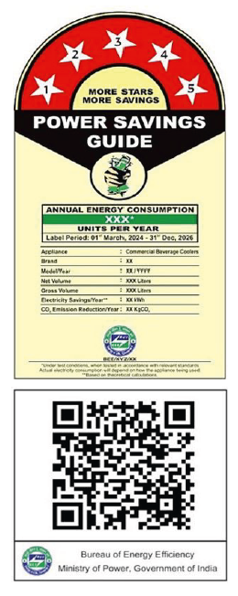
Standards & Labeling Program
  S&L program was launched by BEE with following key objectives
To reduce the energy consumption of appliances without diminishing the service levels
To create awareness amongst the consumers, to make informed decision considering the cost effectiveness & energy performance while purchasing appliances
To monitor and verify energy savings that incur annually through sale of energy efficient appliances.

Slide 3




Key Achievements of S&L Program in FY 2022-2023
Electricity Saved
81.64 Billion Unit
Equivalent CO₂ Emission
Reduction
58.01 Million tons
Equivalent Cost Saving
INR 54,323 Crore
Source: Impact of Energy Efficiency Measures for the Year 2022-23

Slide 4

List of 38 Appliances/Equipment under S&L Program
  Frost Free Refrigerator
  Direct Cool Refrigerator
  Deep Freezers
  Room Air Conditioner (Variable Speed)
  Room Air Conditioner (Fixed Speed)
  RAC (Cassette, Floor Standing Tower, Ceiling, Corner AC)
  Light Commercial AC Fixed Speed
  Stationary Storage Type Electric Water Heater
  Tubular Fluorescent Lamps
  LED LAMPS
  Ultra-High Definition (UHD) Televisions
  Colour Television
  Distribution Transformer
  Ceiling Fan
  Chillers
  Washing Machine (Semi/Top Load/Front Load)
  General Purpose Industrial Motor
  Agricultural Pump Set
  Domestic Gas Stove
  Computer
  Ballast
  Office Automation Products
  Diesel Engine Driven Moonset Pumps for Agricultural Purposes
  Solid State Inverter
  Diesel Generator Set
  Microwave Oven
  Solar Water Heater
  Air Compressors
  High Energy Li-Battery
  Tyres/Tires
  Side by Side/Multi Door Refrigerator
  Pedestal Fan
  Table/Wall Fan
  Induction Hob
  Solar photovoltaic module
  Packaged Boiler
  Commercial Beverage cooler
  Grid Connected Solar Inverter
Mandatory
Voluntary
Standards and Labeling program implemented by Bureau of Energy Efficiency (BEE) as per the provisions of section 13 and 14 of Energy Conservation (EC) Act of 2001.
Currently 38 appliances are covered, out of which, 16 under mandatory regime and 22 under voluntary regime.
Notes:
Beginning with the journey so far, as we all know that Ag Pumps have been launched in S&L program under

Slide 5
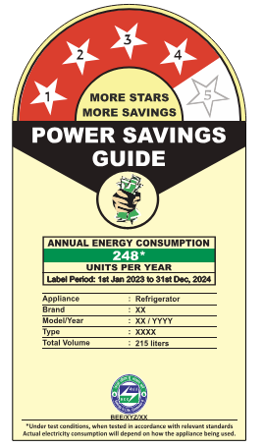
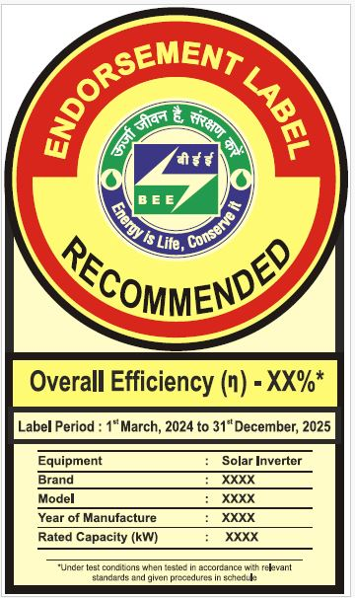

Types of Labels
Comparative Labels
Endorsement Label
Notes:
Add Transformer label latest label

Slide 6
Overview of Standards & Labeling Program for Liquefied Petroleum Gas (LPG) Stove

Slide 7
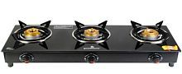
Journey of LPG Stove Labelling Program
2014
Launched voluntary policy for LPG Stove
2019
6th June 2019:
Extension of validity of existing star table till 30th June 2021
2021
29th November 2021: Extension of validity of existing star table till 31st December 2022
2022
Extend the validity period under voluntary phase till 31st December, 2024

Slide 8
Scope of LPG Stove
The domestic gas burning appliance consisting of single and multiple burners, injector jets, gas taps, burner pan supports, piping and fitting intended for use with Liquified Petroleum Gas at 30 gf /cm² gas inlet pressure.
The appliances is usable with only using liquefied Petroleum Gas(LPG) and not with any other family gases.
Pressure regulator is not included as a part of the stove.
The Star Labeling requirements for Domestic Gas Stove using liquefied Petroleum Gas being manufactured, import and sold in India.
For Domestic LPG Stove, the lowest thermal Energy Efficiency of a burner of the stove (having one or more number of burners) is considered for Star labeling.

Slide 9
Testing Guidelines – Domestic LPG Stove
Test standards and procedure for Domestic Gas Stoves are in accordance with IS 4246:2002 – with amendments from time to time.
Thermal Efficiency : The thermal efficiency of Domestic Gas Stoves using Liquefied Petroleum Gas (LPG) shall be determined as per test procedure specified in “Clause 26 of IS 4246: 2002” – with amendments from time to time.
Manufactures are required to submit the test report from BIS/BIS Approved/NABL Certificate/CSIR Laboratory only

Slide 10
Star Rating Table of LPG Stove
LPG Stove is currently under voluntary phase with validity period from 1st Jan,2024 to 31st Dec, 2024.
The number of stars displayed on the star label is between one to five star. Here 5 star is most thermal efficient and 1 star is least efficient.
Validity from 1st Jan 2014 to 31st Dec 2024
Star Rating | Thermal Efficiency (As per IS 4246:latest)
1 Star | If Thermal efficiency ≥68% & <72%
2 Star | If Thermal efficiency ≥72% & <75%
3 Star | If Thermal efficiency ≥75% & <78%
4 Star | If Thermal efficiency ≥78% & <81%
5 Star | If Thermal efficiency ≥81%

Slide 11
Thank You
Contact us:
Kamran.shaikh@beeindia.gov.in pranjan09@beeindia.gov.in

